Slide 2
HyLAC: Hybrid Linear Assignment solver in CUDA
Samiran Kawtikwar*, Rakesh Nagi*†
*University of Illinois Urbana-Champaign, Urbana, IL, USA
†Singapore University of Technology and Design, Singapore

Slide 3
Background
Our Solutions
Evaluation

Slide 4


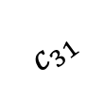
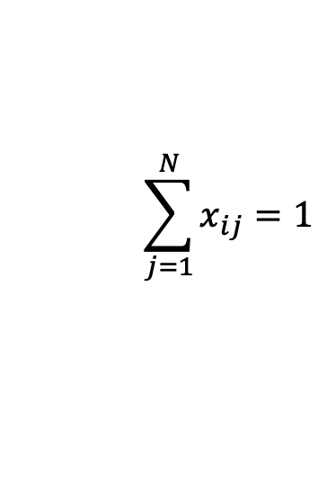
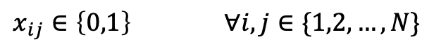
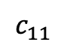
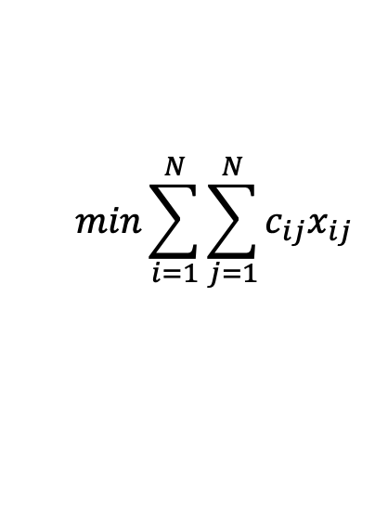
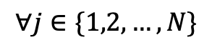
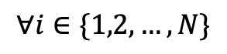
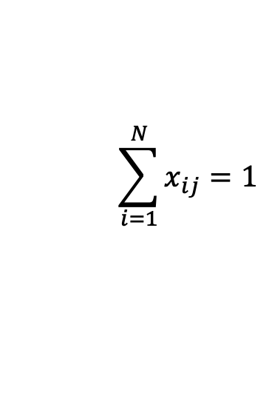
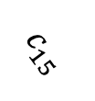
Linear Assignment Problem (LAP)
$$c_{11}$$
$$min\sum_{i=1}^{N}{\sum_{j=1}^{N}{c_{ij}x_{ij}}}$$
1
1
$$c_{31}$$
2
2
$$\sum_{j=1}^{N}{x_{ij}}=1$$
$$∀i∈\{1,2,…,N\}$$
3
3
$$c_{15}$$
$$\sum_{i=1}^{N}{x_{ij}}=1$$
4
4
$$∀j∈\{1,2,…,N\}$$
5
5
$x_{ij}∈\left\{0,1\right\}$ $∀i,j∈\{1,2,…,N\}$

Slide 5
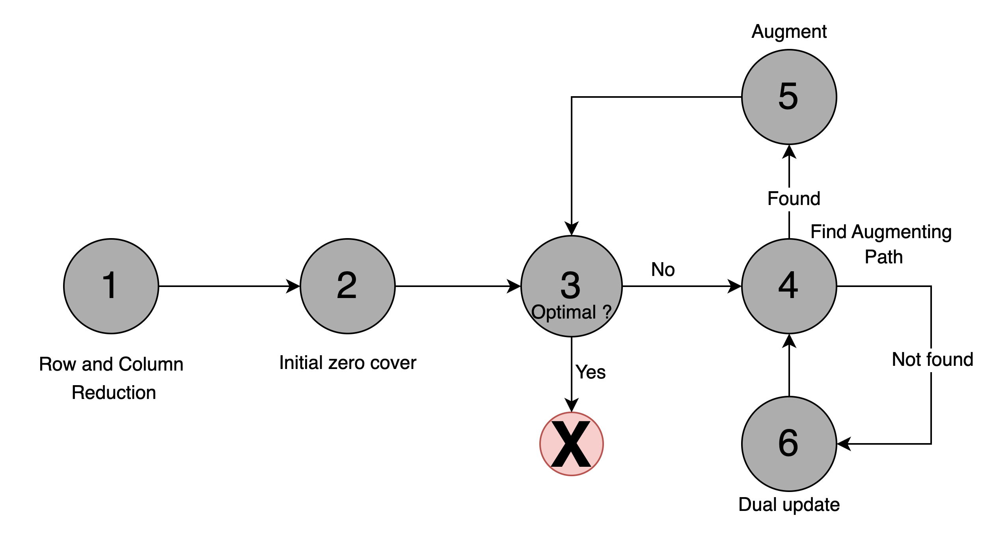
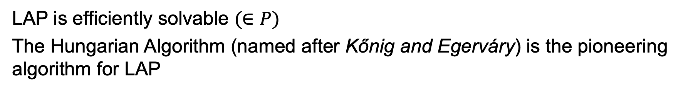
Hungarian Algorithm
LAP is efficiently solvable $(∈P)$
The Hungarian Algorithm (named after Kőnig and Egerváry) is the pioneering algorithm for LAP
HA sketch (6-step procedure):
Row and column reduction
Initial zero cover
Check optimality
Find augmenting path
Found: augment and go to 3
Not found: dual update and go to 4

Slide 6
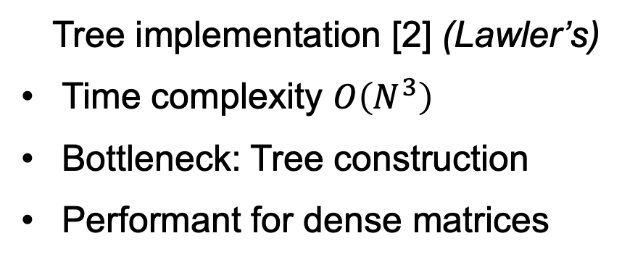
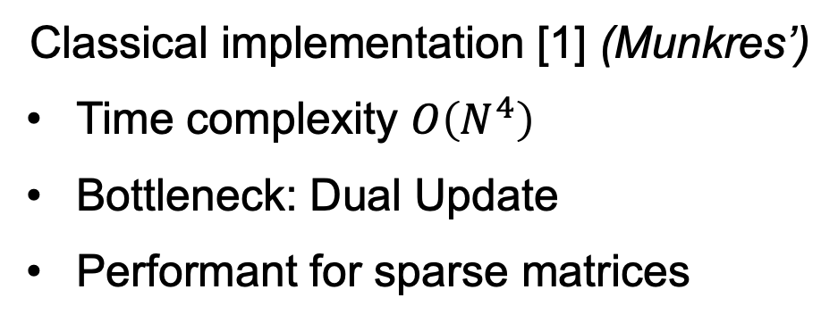
Two implementations of Hungarian Algorithm (HA)
Classical implementation [1] (Munkres’)
Time complexity $O\left(N^{4}\right)$
Bottleneck: Dual Update
Performant for sparse matrices
Tree implementation [2] (Lawler’s)
Time complexity $O\left(N^{3}\right)$
Bottleneck: Tree construction
Performant for dense matrices
The main difference in augmenting path search (when path not found): Classical: Generate new candidate and find the path from scratch
Tree: Extend the current search tree until path is found

Slide 7
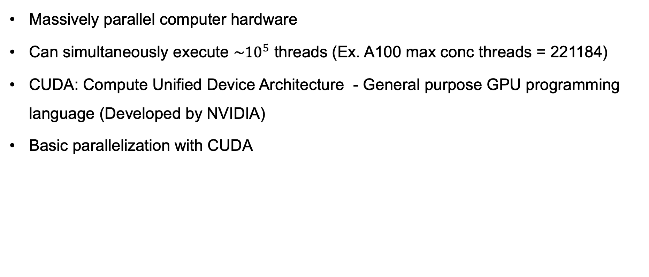
Intro to Graphics Processing Units (GPUs)
Massively parallel computer hardware
Can simultaneously execute $\sim {10}^{5}$ threads (Ex. A100 max conc threads = 221184)
CUDA: Compute Unified Device Architecture - General purpose GPU programming language (Developed by NVIDIA)
Basic parallelization with CUDA
T0 | T1 | T2 | T3 | T4
a
1 | 4 | 3 | 5 | 2
b
2 | 8 | 6 | 10 | 4
a + b
3 | 12 | 9 | 15 | 6

Slide 8
Accelerating HA using GPUs
General strategy:
Find multiple augmenting paths and pivot [3], [4]
Easy to
parallelize
Easy to parallelize
Hard to
parallelize
Easy to
parallelize

Slide 9
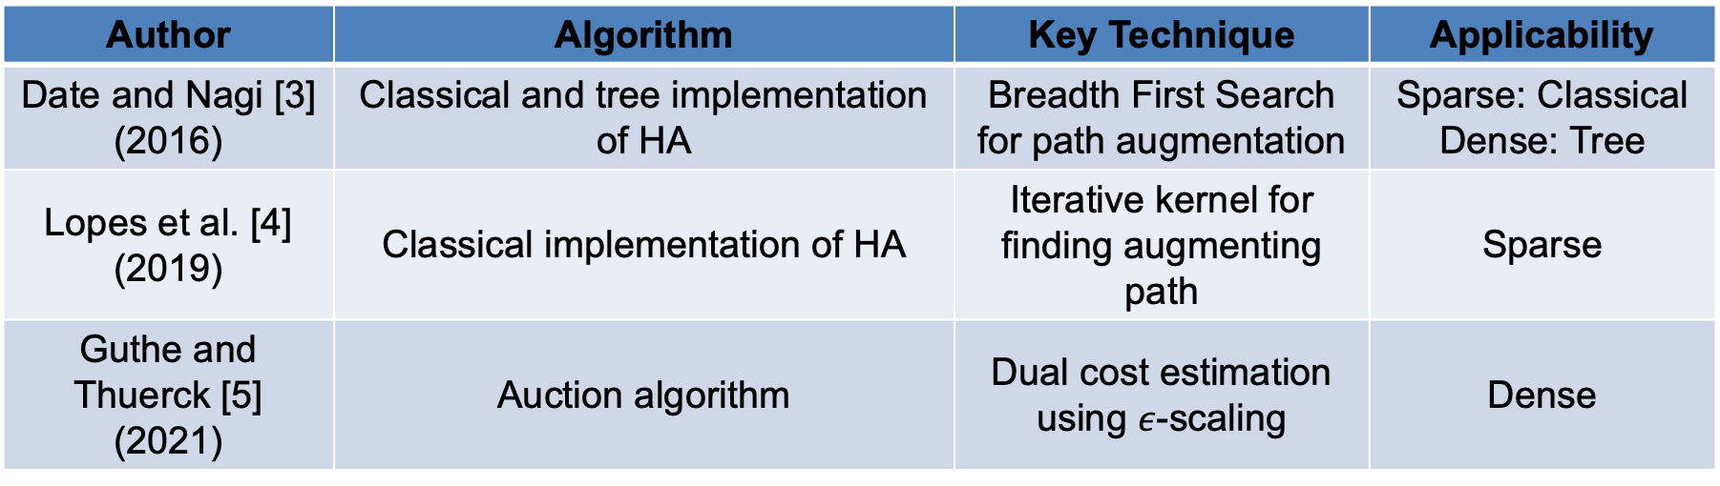
Existing GPU solutions for LAP
Author | Algorithm | Key Technique | Applicability
Date and Nagi [3] (2016) | Classical and tree implementation of HA | Breadth First Search for path augmentation | Sparse: Classical Dense: Tree
Lopes et al. [4] (2019) | Classical implementation of HA | Iterative kernel for finding augmenting path | Sparse
Guthe and Thuerck [5] (2021) | Auction algorithm | Dual cost estimation using $ε$-scaling | Dense
Key Problem: No unified solution for a general problem instance

Slide 10
Background
Our Solutions
Evaluation

Slide 11
Our Solution
HyLAC (Hybrid Linear Assignment solver in CUDA) presents:
High performing classical and tree implementation
A framework that can switch between the implementations
Outline:
Improvement to classical implementation
Improvements to tree implementation
Hybrid framework

Slide 12
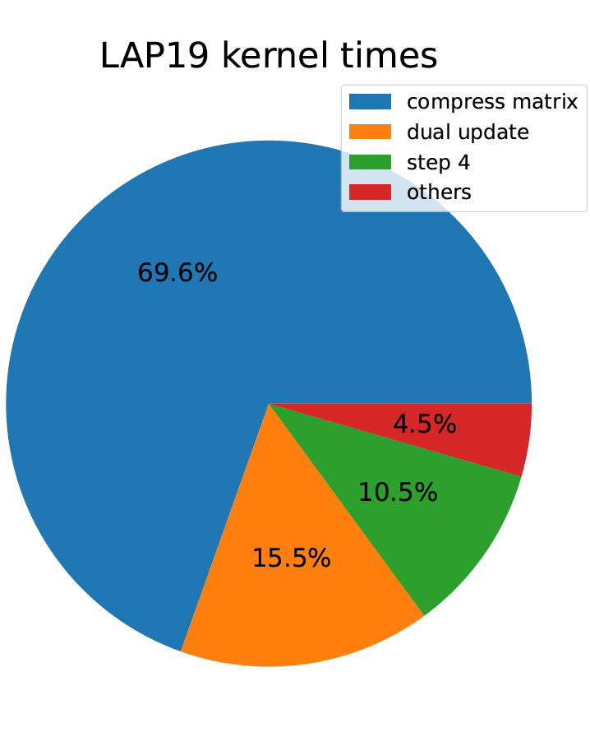
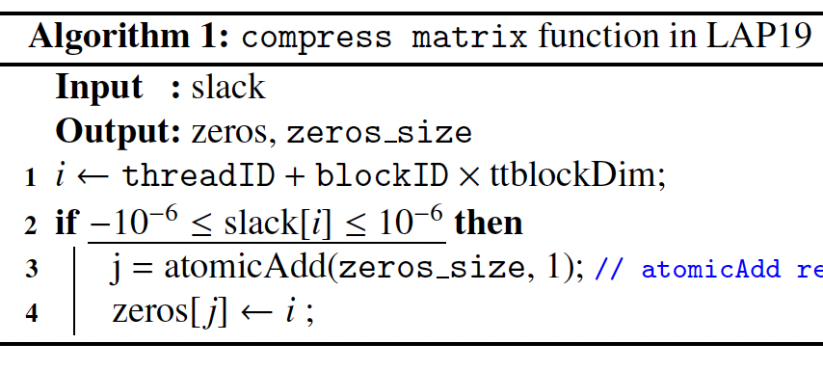
Improvement to classical HA
Lopes et al. (LAP19) is the fastest classical HA implementation on GPUs
The augmenting path search (step 4) consists of:
Compress matrix
Find augmenting path
Compress matrix is the bottleneck instead of dual update!
All threads compete for same memory!
Aggregate time taken by kernels N=4096
for Lopes et al. (LAP19)

Slide 13
Improvement to classical HA
Our solution: Privatization
Address 1 | Total (3)
Address 2 | Total (2)
Memory address | Total value (5)
Memory address | Total value (5)
High contention
Low contention

Slide 14
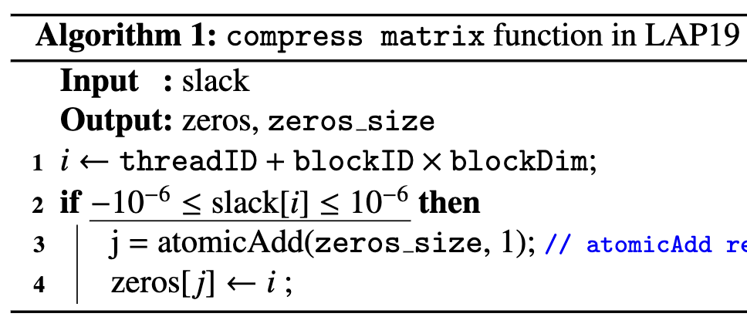
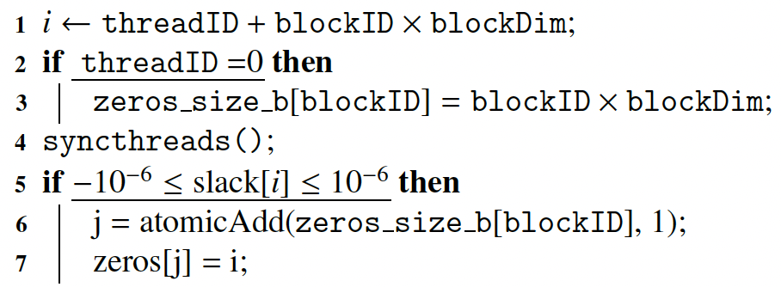
Improvement to classical HA
Our solution: Privatization
Only a subset of threads compete for same memory

Slide 15
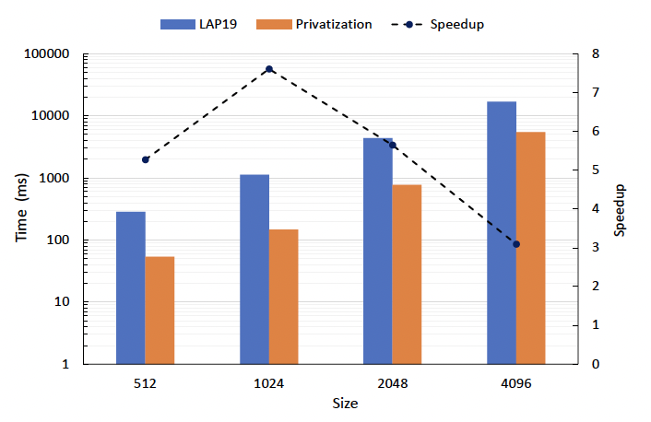
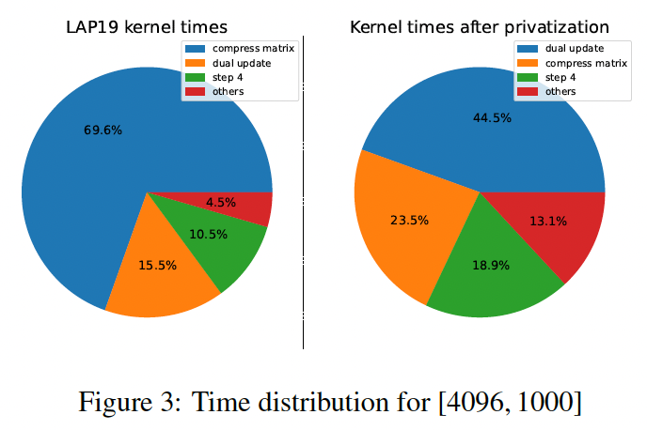
Improvement to classical HA
Privatization impact

Slide 16
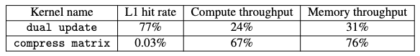
Improvement to classical HA
Kernel Fusion
Dual update and compress matrix, implemented as separate kernels.
Separating kernels washes off local cache, causing expensive memory accesses
L1 hit rate of kernels for problem [4096, 1000]

Slide 17
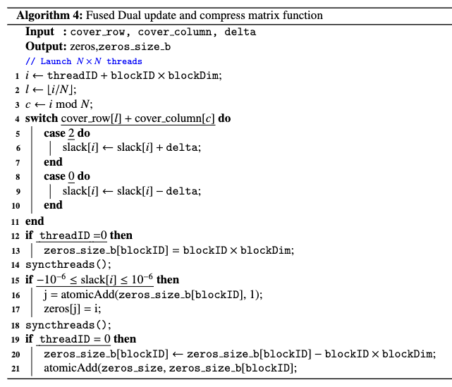
Improvement to classical HA
Kernel Fusion:
Idea:
Combine dual update and
compress matrix kernels
Dual
update
Slack stored in cache
Slack read from cache
Compress
Matrix

Slide 18
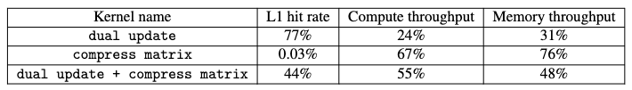
Improvement to classical HA
Kernel Fusion
Improvements:
L1 hit rate of fused vs unfused kernels for problem [4096, 1000]

Slide 19
Improvement to classical HA
Kernel Fusion
Improvements:
Privatization vs Fusion times for range 1000

Slide 20


Improvement to tree HA
Date and Nagi 2016 (LAP16) is the only tree HA implementation on GPUs
Bottleneck: Augmenting path search (BFS kernel)
BFS on GPUs:
Basic idea: use underlying parallelism to generate the next frontier from previous
Problem : Too many CPU-GPU synchronizations
BFS representation

Slide 21
Improvement to tree HA
Date and Nagi 2016 (LAP16) is the only tree HA implementation on GPUs
Bottleneck: Augmenting path search (BFS kernel)
Current approach
New approach
Find augmenting path using BFS
Find augmenting path using iterative approach
found
not found
found
not found
Augment
Extend current search tree until path found (More BFS)
Augment
Extend current search tree until path found (More BFS)

Slide 22
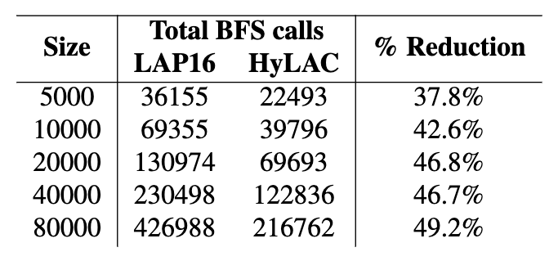
Improvement to tree HA
Improvement:
Reduction in BFS kernel calls
Reduction in BFS calls for range = 1000

Slide 23
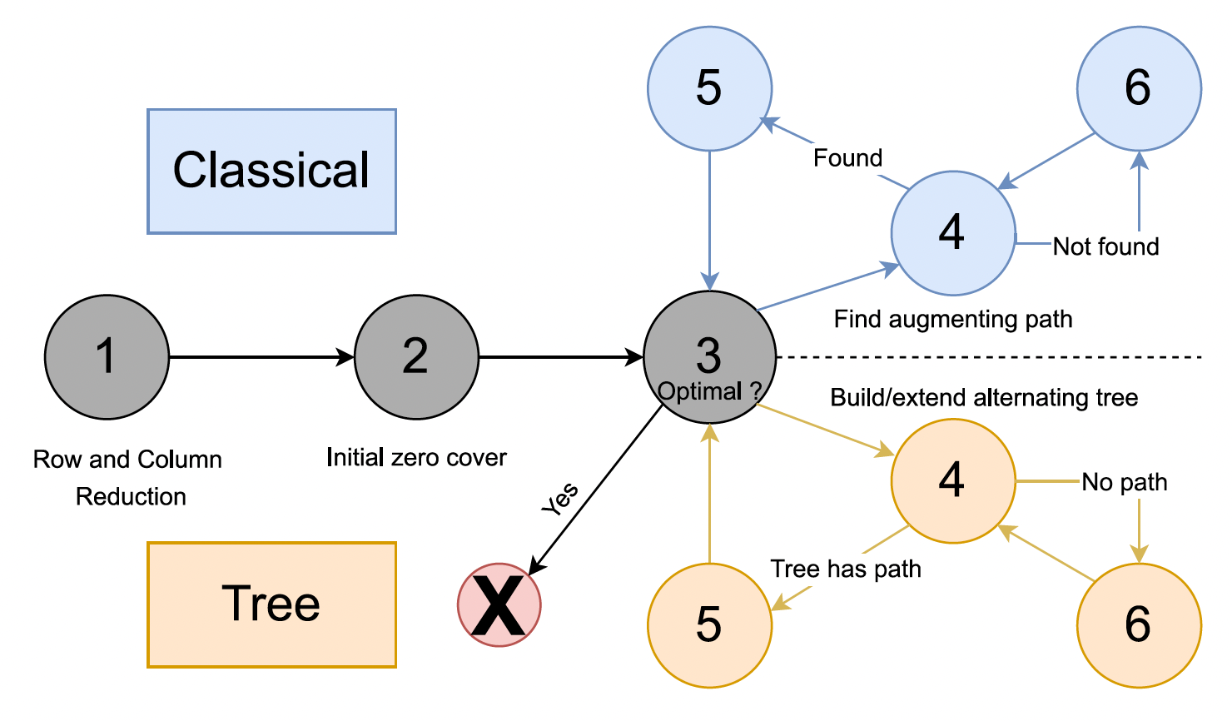
Hybrid Framework
We blend the classical and tree HA in the following way:
Classical HA
Benefit:
On each iteration at Step 3:
Option to chose between tree and classical HA
Tree HA
New solution:
Develop strategies to decide the implementation

Slide 24
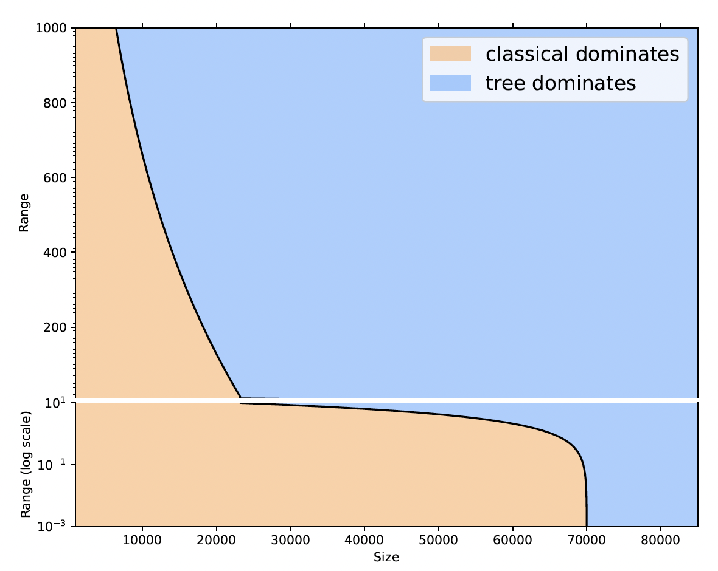
Hybrid Framework
Strategies
Preprocessing based:
Classify the given problem instance into classical or tree region
Runtime based:
Monitor and switch the implementation during runtime
Performance boundary between classical and tree HA

Slide 25
Background
Our Solutions
Evaluation

Slide 26
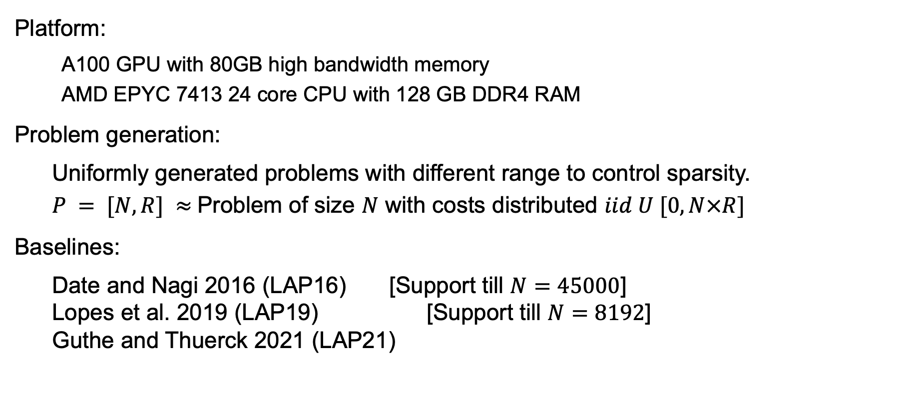
Performance Evaluation
Platform:
A100 GPU with 80GB high bandwidth memory
AMD EPYC 7413 24 core CPU with 128 GB DDR4 RAM
Problem generation:
Uniformly generated problems with different range to control sparsity.
$P = [N, R] ≈$Problem of size $N$ with costs distributed $iid U [0,N×R]$
Baselines:
Date and Nagi 2016 (LAP16) [Support till $N=45000$] Lopes et al. 2019 (LAP19) [Support till $N=8192$] Guthe and Thuerck 2021 (LAP21)

Slide 27
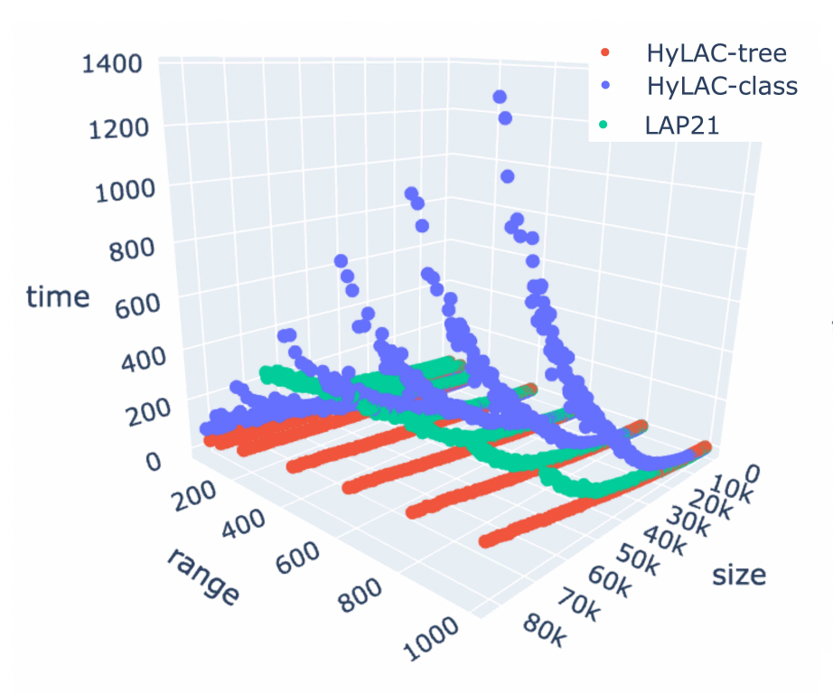
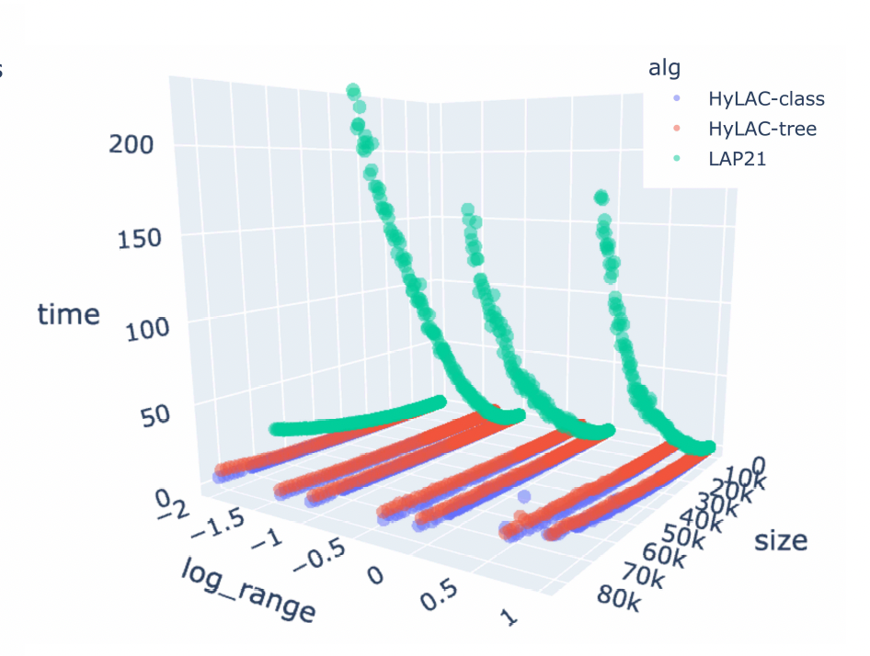


Performance Evaluation
Comparison with LAP21
Low range
High range
Max speedup $99.98×$
Max speedup $6.14×$

Slide 28
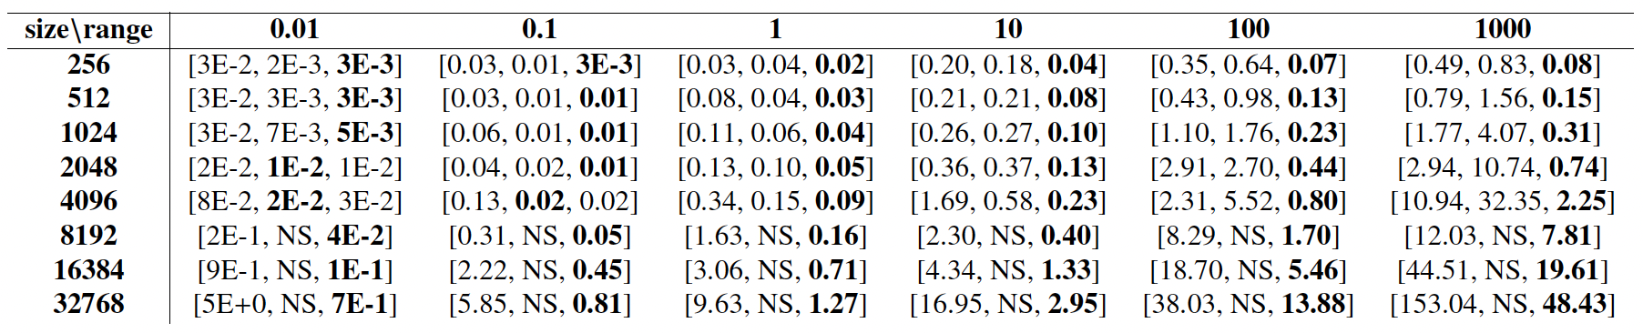

Performance Evaluation
Comparison with LAP16 (tree) and LAP19 Format: [LAP16, LAP19, HyLAC]
NS: Not supported
Geomean speedup: $2.86×$

Slide 29
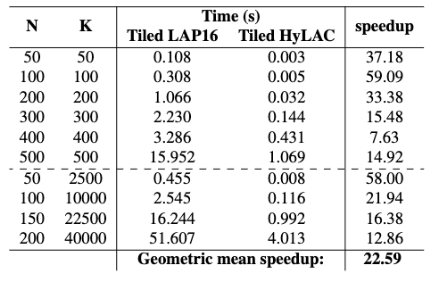
Performance Evaluation
Tiled LAP:
Solving batch of K small LAPs (useful in polyatomic branching [6], [7], [8])
Tiled LAP 16 vs HyLAC-classical

Slide 30
Conclusions
We present:
Fastest HA classical and HA tree implementations
A Hybrid mechanism to switch between classical and tree implementations at any iteration
HyLAC is a single well-performing solution for all types of problems.
Allows preprocessing and runtime-based switching strategies to enable further research
Final speedups (Geomean): 6.19x single problem, 22.59x tiled problem
Acknowledgements
This research is a part of the Delta research computing project, which is supported by the National Science Foundation (award OCI 2005572), and the State of Illinois. Delta is a joint effort of the University of Illinois at Urbana-Champaign and its National Center for Supercomputing Applications.
We are grateful to NVIDIA's Applied Research Accelerator Program for donating two A100 GPUs, which were extremely helpful in the development stages of this work.

Slide 31

References
J. Munkres, Algorithms for the Assignment and Transportation Problems, Journal of the Society for Industrial and Applied Mathematics 5 (1) (1957) 32–38, publisher: Society for Industrial and Applied Mathematics.
E. L. Lawler, Combinatorial optimization: networks and matroids, Holt, Rinehart and Winston, New York, 1976.
K. Date, R. Nagi, GPU-accelerated Hungarian algorithms for the Linear Assignment Problem, Parallel Computing 57 (2016) 52–72. [Available at: https://rapids.ai/]
P. A. Lopes, S. S. Yadav, A. Ilic, S. K. Patra, Fast block distributed CUDA implementation of the Hungarian algorithm, Journal of Parallel and Distributed Computing 130 (2019) 50–62.
S. Guthe, D. Thuerck, Algorithm 1015: A Fast Scalable Solver for the Dense Linear (Sum) Assignment Problem, ACM Transactions on Mathematical Software 47 (2) (2021) 18:1–18:27. doi:10.1145/3442348.
K. Date, R. Nagi, Level 2 reformulation linearization technique–based parallel algorithms for solving large quadratic assignment problems on graphics processing unit clusters, INFORMS Journal on Computing 31 (4) (2019) 771–789.
S. Vadrevu, R. Nagi, A gpu accelerated dual-ascent algorithm for the multidimensional assignment problem in a multitarget tracking application, in press (2022).
O. H. Reynen, Gpu-accelerated algorithms for the resource-constrained assignment problem, Master’s thesis, University of Illinois at Urbana-Champaign, Champaign, IL USA (2020).

Slide 32
Thank you!
Questions...
samiran2@Illinois.edu

